Slide 1
Energy Bands in Solids
Direct and Indirect Bandgap
Classification of Electronic Materials
Effective mass of an electron: E-k diagram
Dr. Elangovan Elamurugu
iDARE Laboratory, Department of Physics and Nanotechnology, SRMIST

Slide 2
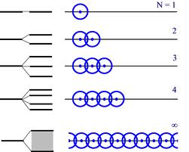
Energy Band in Solids
The band theory of solids explains the formation of energy bands and determines whether a solid is a conductor, semiconductor or insulator.
The existence of continuous bands of allowed energies can be understood starting with the atomic scale.
The electrons of a single isolated atom occupy atomic orbitals, which form a discrete set of energy levels.
When two identical atoms are brought closer, the outermost orbits of these atoms overlap and interact.
When the wave functions of electrons of different atoms begin to overlap considerably, the energy levels corresponding to those wave functions split.
These energy levels are so close that they form an almost continuous band.
The width of the band depends upon the degree of overlap of electrons of adjacent atoms and is largest for the outermost atomic electrons.
In solids, the energy band corresponding to outermost shells are called valence band and the energy formed by conduction levels of various atoms are called conduction band.

Slide 3
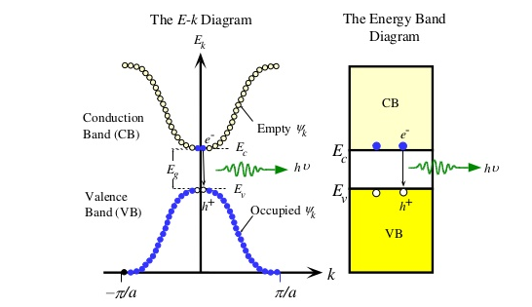
E-k Diagram
In the energy band diagram, conduction band is represented above the valance band. The energy gap between the valance band and the conduction band is known as forbidden Energy Gap E_{g}.
The above E-k diagram shows characteristics of a particular semiconductor material. It shows the relationship between the energy and momentum of available quantum mechanical states for electrons in the material. The k vector roughly corresponds to momentum for free particles, which is called as the crystal momentum.

Slide 4
Energy Band in Solids
Valance Band:
A band occupied by valence electrons and is responsible for electrical, thermal and optical properties of solids and it is filled with charge carriers only at temperature 0K.
The valence band is the band of electron orbitals that electrons can jump out of, moving into the conduction band when excited.
The valence band is simply the outermost electron orbital of an atom of any specific material that electrons actually occupy.
This is closely related to the idea of the valence electron.
Conduction Band:
A band corresponding to the orbits other than valence electrons is called conduction band and is the highest energy band and it is completely empty at 0K.
The energy difference between the highest occupied energy state of the valence band and the lowest unoccupied state of the conduction band is called as the band gap and is indicative of the electrical conductivity of a material.
A large band gap means that a lot of energy is required to excite valence electrons to the conduction band.

Slide 5
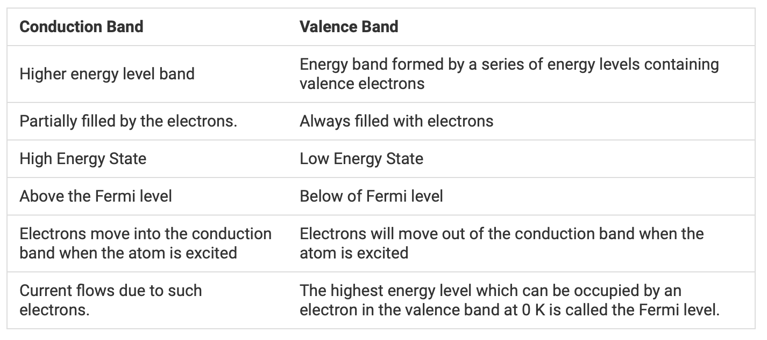
Energy Band in Solids

Slide 6
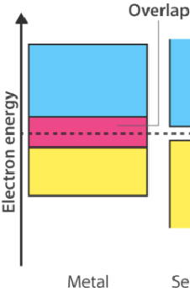
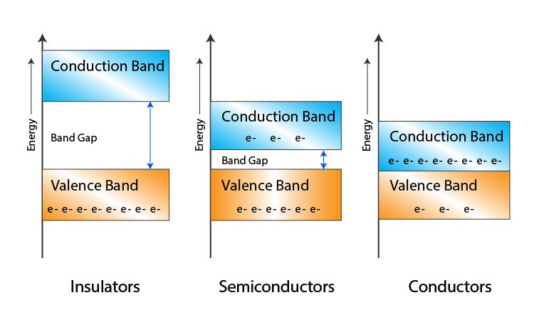
Energy Band in Solids
When the valence band and conduction band overlap as they do in metals, electrons can readily jump between the two bands meaning the material is highly conductive.
The difference between conductors, insulators, and semiconductors can be shown by how large their band gap is Insulators are characterized by a large band gap, so a prohibitively large amount of energy is required to move electrons out of the valence band to form a current.
Conductors have an overlap between the conduction and valence bands, so the valence electrons in such conductors are essentially free.

Slide 7
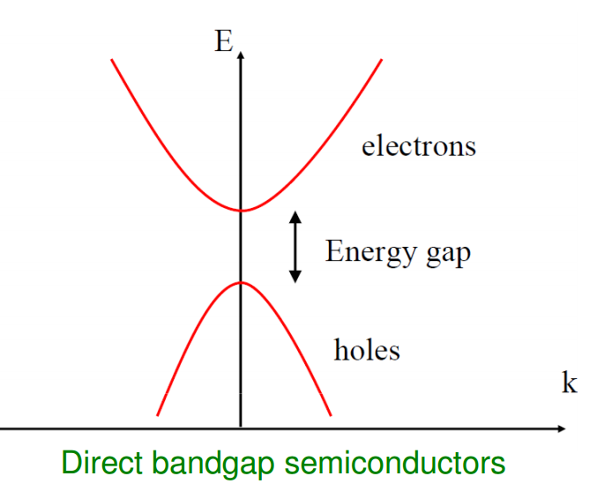
Direct Bandgap
The band gap of a semiconductor is always one of two types as direct band gap and Indirect band gap.
The band gap represents the minimum energy difference between the top of the valence band and the bottom of the conduction band.
However, top of the valence band and the bottom of the conduction band are not generally at the same value of the electron momentum.
Minimum-energy state in the conduction band and the maximum-energy state in the valence band are each characterized by a certain crystal momentum and k- vector in the Brillouin zone.
If the k-vectors of conduction band minima (CB-minima) and valence Band maxima (VB-maxima) are same, it is called as Direct Bandgap.

Slide 8
Direct Bandgap
In direct bandgap semiconductor, the energy is conserved by means of emitting a photon. Such transitions are called as radiative transitions.
Relative carrier lifetime is small in case of direct band gap semiconductor.
Example of direct bandgap semiconductors are GaAs, InAs, InSb, GaN, InN, ZnO, CdSe, and ZnS.
GaAs emits light in Infra-red region.
Direct bandgap semiconductors are used to make optical devices such as LEDs and semiconductor lasers.
A carrier lifetime is defined as the average time it takes for a minority carrier to recombine. The process through which this is done is typically known as minority carrier recombination.
The E-k diagram on the left shows characteristics of a particular semiconductor material. It shows the relationship between the energy and momentum of available quantum mechanical states for electrons in the material.

Slide 9
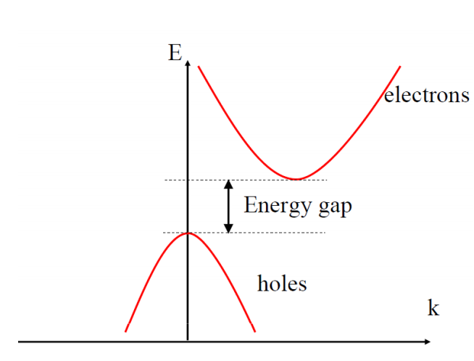
Indirect Bandgap
If the k-vectors of conduction band minima (CB-minima) and valence Band maxima (VB-maxima) differs from each other, it is called as Indirect bandgap.
In this case, the momentum is not same for conduction band minima and valence band maxima.
In an indirect bandgap, a photon cannot be emitted because the electron must pass through an intermediate state and transfer momentum to the crystal lattice.
Examples of indirect bandgap semiconductors are Si, Ge, and GaP
The E-k diagram on the left show the characteristics of a particular semiconductor material. It shows the relationship between the energy and momentum of available quantum mechanical states for electrons in the material.

Slide 10
Classification of Electronic Materials
Based on the energy band diagram materials or solids are classified into conductors, insulators and semiconductors.
Conductors:
In conductors, there is no forbidden gap between the valence band and conduction band.
It is observed that the valence band overlaps with the conduction band in metals.
There are sufficient numbers of free electrons, available for electrical conduction and due to the overlapping of the two bands, there is an easy transition of electrons from one band to another band takes place.
Resistivity of conductors is very small, and it is in the order of 10⁻⁹ to 10⁻⁴ Ω m. Examples: Na, Al, Cu, Ni, Cu, Ag, etc.
Insulators:
In insulators, the width of forbidden energy gap between the valence band and conduction band is very large, normally in the order of 3 eV to 5.47 eV.
Due to large energy gap, electrons cannot move from valance band to conduction band. The electrical resistivity of insulators is in the order of 10³ to 10¹⁷ Ω-m.

Slide 11
Classification of Electronic Materials
Since the electrons are tightly bound to the nucleus, no valence electrons are available.
It is estimated that the electrical field in the order of 106 V/m would be required to make the electron to overcome the forbidden gap.
Examples: Wood, rubber, glass.
Semiconductors:
The substances whose conductivity lies in between conductors and insulators are called as semiconductors. The properties of semiconductors are given below:
At temperature 0K, a semiconductor becomes an insulator.
The electrical conductivity of a semiconductor is increased with increase in temperature.
The absence of an electron in the valance band of a semiconductor is known as hole.
The hole occur only in the valance band.
Like electrons, the hole in the valance band also conducts electricity in case of a semiconductor.
The electric current in a semiconductor is the sum of the currents due to electron and hole.

Slide 12
Effective mass of an electron
An electron in crystal may behave as if it had a different mass in comparison with the free electron mass.
The effective mass may be anisotropic, and it may even be negative.
The important point is that the electron in a periodic potential is accelerated relative to the lattice in an applied electric or magnetic field as if its mass is equal to an effective mass.
The movement of an electron in a lattice will, in general, be different from that of an electron in free space.
In addition to an externally applied force, there are internal forces in the crystal due to positively charged ions or protons and negatively charged electrons, which will influence the motion of electrons in the lattice.
So, the total force can be written as follows:
F_{total} = F_{ext} + F_{int} = ma (1)
Where F_{total}, F_{ext}, and F_{int} are total force, externally applied force, and internal force, respectively. The parameter a is acceleration and m is the rest mass of the particle.
Since it is very difficult to take into account of all the internal forces, we can write the following equation:
F_{ext} = m*a (2)
Where the acceleration a is now directly related to the external force. The parameter m*, called the effective mass, takes into account the particle mass and also takes into account the effect of the internal forces.

Slide 13

Effective mass of an electron
To use an agreement for the effective mass concept, consider the difference in motion between a glass marble in a container filled with water and in a container filled with oil. In general, the marble will drop through the water at a faster rate than through the oil. The external force in this example is the gravitational force and the internal forces are related to the viscosity of the liquids. Because of the difference in motion of the marble in these two cases, the mass of the marble would appear to be different in water than in oil.

Slide 14
Effective mass of an electron
The effective mass of an electron in a crystal can be related to E vs k curves. E-k curves of semiconductor material contains allowed energy bands that are almost empty of electrons and other energy bands that are almost full of electrons.
Recalling Equation, the energy and momentum are related by
E = p²/2m = ħ²k²/2m (3)
Where m is the mass of the electron. The momentum p and wave number k are related by p=ħk . Taking the derivative of Equation (3) with respect to k,
dE/dk = ħ²k/m = ħp/m (4)
By relating the momentum to velocity, Equation (4) can be written as
(1/ħ)(dE/dk )= p/m = v (5)
Where v is the velocity of the particle. The first derivative of E with respect to k is related to the velocity of the particle.

Slide 15
Effective mass of an electron
If we now take the second derivative of E with respect to k, we have
d²E/dk² = ħ²/m (6)
Equation (6) can be rewritten as
(1/ħ²)d²E/dk² = 1/m* (7)
The second derivative of E with respect to k is inversely proportional to the mass of the particle. For the case of a free electron, the mass is a constant (non relativistic effect), so the second derivative function is a constant.
If we apply an electric field to the free electron and use Newton’s classical equation of motion, then
F_{ext} = m* a = eE (8)
where a is the acceleration, E is the applied electric field, and e is the magnitude of the electronic charge.

Slide 16
Effective mass of an electron
The effective mass is a parameter that relates the quantum mechanical results to the classical force equations.
In most instances, the electron in the bottom of the conduction band can be thought of as a classical particle whose motion can be modeled by Newtonian mechanics, provided that the internal forces and quantum mechanical properties are taken into account through the effective mass.
If we apply an electric field to the electron in the bottom of the allowed energy band, then the acceleration is
a = eE/m* (9)
where m* is the effective mass of the electron.
m* = eE/a (10)

Slide 17
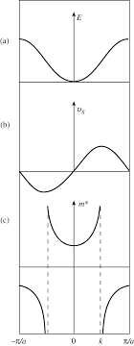
Effective mass of an electron

